Slide 1
Oracle Database Prático 1
cleberm@kyndryl.com
Fev 2022

Slide 2
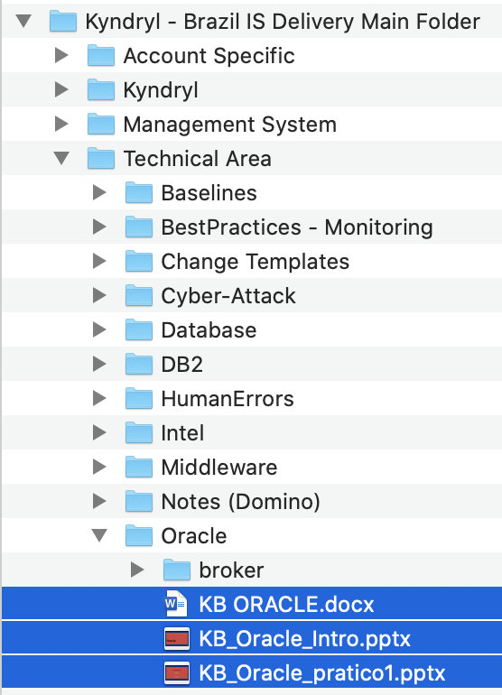
Udemy DBA Oracle Essencial - Aprenda do zero! Tenha em mãos o essencial para administrar bancos de dados Oracle iniciando do zero e com muito SQL! (56 kB) https://kyndryl.udemy.com/course/curso-dba-oracle/ Banco de Dados Oracle Completo: SQL+PLSQL+Modelagem de Dados CURSO COMPLETO ORACLE 21c - Incluindo 3 cursos: SQL PL/SQL e Modelagem de Banco de Dados - Abrangendo versões 11g a 21c (21 kB) https://kyndryl.udemy.com/course/banco-de-dados-oracle-completo-sqlplsqlmodelagem-de-dados/
Guia rápido
Box: Kyndryl - Brazil IS Delivery Main Folder/Technical Area/Oracle/KB ORACLE.docx Link: https://kyndryl.box.com/s/70imzb6kcw69pguo9ohce5iiyx8jjgtq
Softwares:
Editor de Texto:
https://na.artifactory.swg-devops.com/ui/native/g2o-asset-repo/Notepad++%20-%20IUA/7.8
Outros Softwares:
https://na.artifactory.swg-devops.com/ui/native/g2o-asset-repo
Cursos

Slide 3
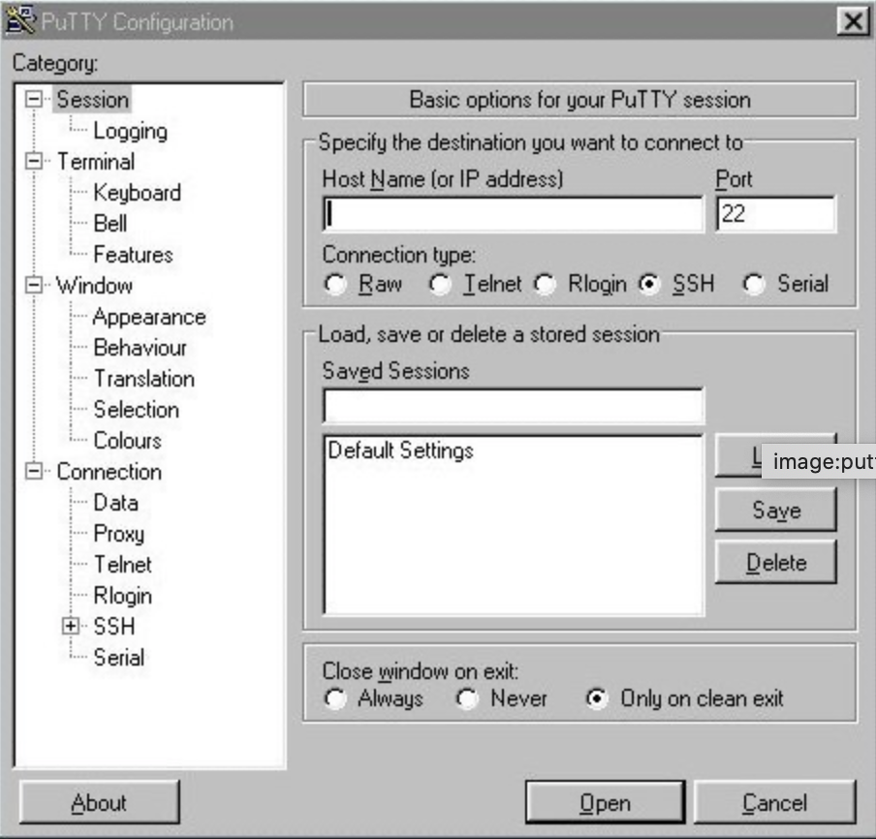
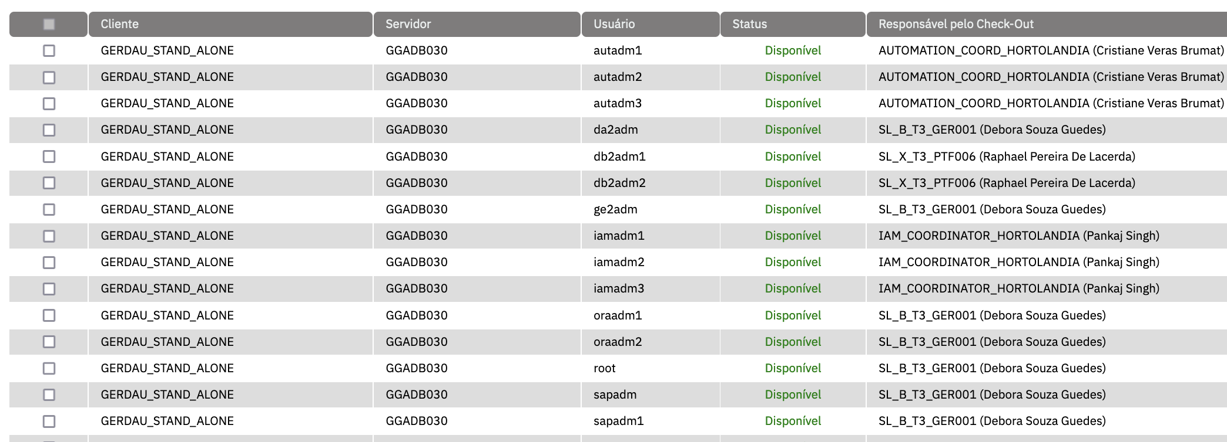

Conexão
# Conexão no servidor putty
Porta: 2222
IP=9.25.103.166
# Conexão no servidor
ssh -p 2222 teste2@9.25.31.131 (ou via putty)
teste2@9.25.31.131's password: XXXXXXX
Last login: Wed Feb 2 10:03:11 2022 from 10.0.2.2
Welcome to Oracle Linux Server release 7.6 (GNU/Linux 4.14.35-1844.4.5.el7uek.x86_64)
The Oracle Linux End-User License Agreement can be viewed here:
* /usr/share/eula/eula.en_US
For additional packages, updates, documentation and community help, see:
* http://yum.oracle.com/
# Verifique usuário e grupos
id
uid=54324(teste2) gid=54321(oinstall) groups=54321(oinstall),54322(dba),54331(oraadmin)

Slide 4
Processos ativos e instancias configuradas
# Verifica processos ativos de banco (smon)
ps -ef|grep smon| grep -v grep
oracle 3279 1 0 09:37 ? 00:00:00 ora_smon_ORCL
# Verificar processos de listener ativos (inh)
ps -ef|grep inh| grep -v grep
oracle 2872 1 0 09:37 ? 00:00:00 /opt/oracle/product/12.2.0.1/dbhome_1/bin/tnslsnr LISTENER –inherit
# Verificar instances configuradas para esse server (oratab)
grep ":" /etc/oratab
# A colon, ':', is used as the field terminator. A new line terminates
# Entries are of the form:
# $ORACLE_SID:$ORACLE_HOME:<N|Y>:
ORCL:/opt/oracle/product/12.2.0.1/dbhome_1:Y
FAKE:/opt/oracle/product/12.2.0.1/dbhome_1:N
ls -ltr /opt/oracle/product/12.2.0.1/dbhome_1/bin/oracle
-rwsr-s--x. 1 oracle oinstall 407944920 May 8 2019 /opt/oracle/product/12.2.0.1/dbhome_1/bin/oracle

Slide 5
Usuário do banco / variáveis de ambiente.
# Conectar com usuário do banco)
sudo su - oracle
[sudo] password for teste2: XXXXX
Last login: Wed Feb 2 10:03:21 -03 2022 on pts/1
[oracle@localhost ~]$
# Verificando variáveis de ambiente
[oracle@localhost ~]$ env|grep ORA
ORACLE_SID=ORCL
ORACLE_BASE=/opt/oracle
ORACLE_HOME=/opt/oracle/product/12.2.0.1/dbhome_1
# Seta variáveis do ORACLE (oraenv, export)
[oracle@localhost ~]$ . oraenv
ORACLE_SID = [ORCL] ? FAKE
The Oracle base remains unchanged with value /opt/oracle
## oraenv usa o /etc/oratab
[oracle@localhost ~]$ env|grep ORA
ORACLE_SID=FAKE
ORACLE_BASE=/opt/oracle
ORACLE_HOME=/opt/oracle/product/12.2.0.1/dbhome_1
export ORACLE_SID=ORCL
env|grep ORACLE_SID
ORACLE_SID=ORCL

Slide 6
LAB 1 – Processos, sudo e variáveis.
Conecte no servidor com o usuário pessoal
Descubra qual é o usuário do banco ORCL
Liste os processos do smon dos bancos ativos no momento.
Faça o sudo para o usuário do banco ORCL
Liste as variáveis referente ao ORACLE.

Slide 7

Conectando no banco (SQLPLUS)
# Conectou no servidor
# Identificou o usuário do banco e fez o “sudo su - ....”
# Verificou as variáveis de ambiente.(ORACLE_SID, ORACLE_HOME...)
# Conectou no servidor
# Identificou o usuário do banco e fez o “sudo su - ....”
# Variável ORACLE_SID errada ou de um banco que não está ativo (UP).
# Conectar no banco
[oracle@localhost ~]$ sqlplus / as sysdba
SQL*Plus: Release 12.2.0.1.0 Production on Wed Feb 2 16:07:57 2022
Copyright (c) 1982, 2016, Oracle. All rights reserved.
Connected to:
Oracle Database 12c Enterprise Edition Release 12.2.0.1.0 - 64bit Production
SQL>
# Setando valor errado para ORACLE_SID
[oracle@localhost ~]$ export ORACLE_SID=FAKE
# Conectar no banco
[oracle@localhost ~]$ sqlplus / as sysdba
SQL*Plus: Release 12.2.0.1.0 Production on Wed Feb 2 16:06:30 2022
Copyright (c) 1982, 2016, Oracle. All rights reserved.
Connected to an idle instance.
SQL>

Slide 8
SQLPLUS – executando SELECTs
# Dicas:
Cada comando termina com ;
use / para executar o commando anterior
O resultado é texto e precisa ser formato
Formatações mais comuns:
Set linesize 1000
Set pagesize 1000
COL COLUNA1 FORMAT A40
COL COLUNAN FORMAT 99,990.00
SQL> select open_mode,database_role, dataguard_broker, SWITCHOVER_STATUS,guard_status,flashback_on from v$database;
OPEN_MODE DATABASE_ROLE DATAGUAR SWITCHOVER_STATUS GUARD_S
-------------------- ---------------- -------- -------------------- -------
FLASHBACK_ON
------------------
READ WRITE PRIMARY DISABLED NOT ALLOWED NONE
NO
SQL> set linesize 1000
SQL> /
OPEN_MODE DATABASE_ROLE DATAGUAR SWITCHOVER_STATUS GUARD_S FLASHBACK_ON
-------------------- ---------------- -------- -------------------- ------- ------------------
READ WRITE PRIMARY DISABLED NOT ALLOWED NONE NO
SQLPLUS – Quick Reference: https://docs.oracle.com/en/database/oracle/oracle-database/18/sqpqr/index.html#SQPQR101

Slide 9
Checklist Oracle Instance - script
alter system checkpoint;
prompt Instance OK-> STATUS=OPEN, LOGINS=ALLOWED
select instance_name, to_char(STARTUP_TIME, 'dd/mm/yy hh24:mi:ss') dt, status, logins from gv$instance;
prompt Database OK-> OPEN_MODE=READ WRITE (se DATABASE_ROLE=PRIMARY)
select open_mode,database_role, dataguard_broker, SWITCHOVER_STATUS,guard_status,flashback_on from v$database;
prompt Datafiles OK-> somente ONLINE e SYSTEM
select count(*),status from v$datafile group by status;
prompt Temp_files OK-> somente ONLINE e SYSTEM
select distinct status from dba_temp_files;
select distinct status from v$logfile;
alter system switch logfile;
prompt pdbs OK-> RESTRICTED=NO, OPEN_MODE=READ ONLY(PDB$SEED) e READ WRITE (demais bancos)
show pdbs

Slide 10
Checklist Oracle Instance - Analise
Procurar mensagens de erro (ORA-????)
Ver resultado esperado
# Resultado
SQL> Instance OK-> STATUS=OPEN, LOGINS=ALLOWED
INSTANCE_NAME DT STATUS LOGINS
---------------- ----------------- ------------ ----------
ORCL. 02/02/22 09:37:18 OPEN ALLOWED
SQL> Database OK-> OPEN_MODE=READ WRITE (se DATABASE_ROLE=PRIMARY)
OPEN_MODE DATABASE_ROLE DATAGUAR SWITCHOVER_STATUS GUARD_S FLASHBACK_ON
-------------------- ---------------- -------- -------------------- ------- ------------------
READ WRITE PRIMARY DISABLED NOT ALLOWED NONE NO
SQL> Datafiles OK-> somente ONLINE e SYSTEM
COUNT(*) STATUS
---------- -------
3 ONLINE
1 SYSTEM
SQL> Temp_files OK-> somente ONLINE e SYSTEM
STATUS
-------
ONLINE
SQL>
STATUS
-------
System altered.
SQL> pdbs OK-> RESTRICTED=NO, OPEN_MODE=READ ONLY(PDB$SEED) e READ WRITE (demais bancos)

Slide 11
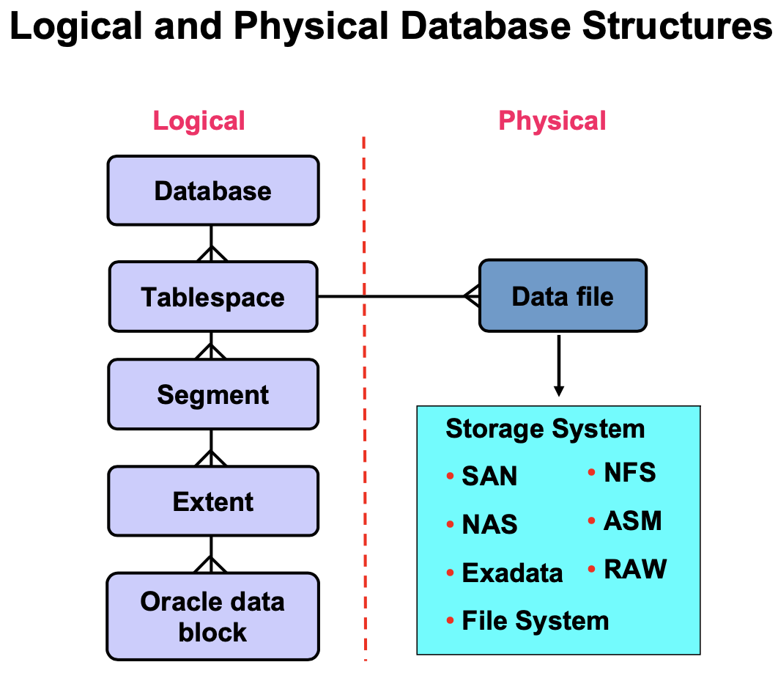
LAB 2 – Listar tablespace e datafiles
# Use o documento:
Box: Kyndryl - Brazil IS Delivery Main Folder/Technical Area/Oracle/KB ORACLE.docx https://kyndryl.box.com/s/70imzb6kcw69pguo9ohce5iiyx8jjgtq
Conecte no banco ORCL
Liste as tablespaces e o percentual de utilização.
Liste os datafiles da tablespace SYSTEM

Slide 12
Oracle logs – alert<sid>.log
# METODO 1 - achando o log
- via banco
[oracle@localhost ~]$ sqlplus / as sysdba
SQL*Plus: Release 12.2.0.1.0 Production on Mon Jan 31 09:18:49 2022
Copyright (c) 1982, 2016, Oracle. All rights reserved.
Connected to:
Oracle Database 12c Enterprise Edition Release 12.2.0.1.0 - 64bit Production
SQL> show parameters dump
NAME TYPE VALUE
------------------------------------ ----------- ------------------------------
background_dump_dest string /opt/oracle/product/12.2.0.1/dbhome_1/rdbms/log
core_dump_dest string /opt/oracle/diag/rdbms/orcl/ORCL/cdump
max_dump_file_size string unlimited
shadow_core_dump string partial
user_dump_dest string /opt/oracle/product/12.2.0.1/dbhome_1/rdbms/log
SQL> show parameters diag
NAME TYPE VALUE
------------------------------------ ----------- ------------------------------
diagnostic_dest string /opt/oracle
SQL> exit
# se tiver o diagnostic_dest
cd /opt/oracle/diag/rdbms/orcl/ORCL/trace
ls -ltr alert*.log
[oracle@localhost trace]$ ls -ltr al*
-rw-r-----. 1 oracle oinstall 325299 Feb 3 09:48 alert_ORCL.log
# se não tiver o diagnostic_dest use o background_dump_dest
cd /opt/oracle/product/12.2.0.1/dbhome_1/rdbms/log
# METODO 2 - achando o log
- via adrci (Automatic Diagnostic Repository Command Interpreter)
[oracle@localhost ~]$ adrci
ADRCI: Release 12.2.0.1.0 - Production on Mon Jan 31 18:03:59 2022
Copyright (c) 1982, 2017, Oracle and/or its affiliates. All rights reserved.
ADR base = "/opt/oracle"
adrci> show homes
ADR Homes:
diag/rdbms/orcl/ORCL
diag/tnslsnr/localhost/listener
adrci> exit
cd /opt/oracle/diag/rdbms/orcl/ORCL/trace
ls -ltr alert*.log
[oracle@localhost trace]$ ls -ltr al*
-rw-r-----. 1 oracle oinstall 325299 Feb 3 09:48 alert_ORCL.log

Slide 13
LAB 3 – alert<sid>.log + tail
Abra duas conexões no servidor de LAB.
Faça sudo para o usuário do banco.
Na conexão 1 :
Encontre o log do banco ORCL e execute:
tail –f alert_ORCL.log
2022-02-03T09:04:36.644669-03:00
Shared IO Pool defaulting to 8MB. Trying to get it from Buffer Cache for process 3300.
===========================================================
Dumping current patch information
===========================================================
No patches have been applied
===========================================================
2022-02-03T09:48:48.710191-03:00
Thread 1 advanced to log sequence 20 (LGWR switch)
Current log# 2 seq# 20 mem# 0: /opt/oracle/oradata/ORCL/redo02.log
Na conexão 2 :
Conecte no banco e execute:
SQL> Alter system switch logfile;
System altered.

Slide 14

Checklist Listener
Procurar mensagens de erro (TNS-????)
Ver resultado esperado
[oracle@localhost ~]$ lsnrctl status listener
LSNRCTL for Linux: Version 12.2.0.1.0 - Production on 31-JAN-2022 12:14:46
Copyright (c) 1991, 2016, Oracle. All rights reserved.
Connecting to (DESCRIPTION=(ADDRESS=(PROTOCOL=IPC)(KEY=EXTPROC1)))
STATUS of the LISTENER
------------------------
Alias LISTENER
Version TNSLSNR for Linux: Version 12.2.0.1.0 - Production
Start Date 31-JAN-2022 09:17:23 <<< DATA/HORA DO START DO LISTENER
Uptime 0 days 2 hr. 57 min. 22 sec
Trace Level off
Security ON: Local OS Authentication
SNMP OFF
Listener Parameter File /opt/oracle/product/12.2.0.1/dbhome_1/network/admin/listener.ora<<< ARQUIVO DE CONFIGURACAO
Listener Log File /opt/oracle/diag/tnslsnr/localhost/listener/alert/log.xml
Listening Endpoints Summary...
(DESCRIPTION=(ADDRESS=(PROTOCOL=ipc)(KEY=EXTPROC1)))
(DESCRIPTION=(ADDRESS=(PROTOCOL=tcp)(HOST=0.0.0.0)(PORT=1521)))
(DESCRIPTION=(ADDRESS=(PROTOCOL=tcps)(HOST=localhost)(PORT=5500))(Security=(my_wallet_directory=/opt/oracle/product/12.2.0.1/dbhome_1/admin/ORCL/xdb_wallet))(Presentation=HTTP)(Session=RAW))
Services Summary...
Service "ORCLXDB" has 1 instance(s).
Instance "ORCL", status READY, has 1 handler(s) for this service...
Service "orcl" has 2 instance(s).
Instance "ORCL", status READY, has 1 handler(s) for this service...
Instance "orcl", status UNKNOWN, has 1 handler(s) for this service...
The command completed successfully
[oracle@localhost ~]$ lsnrctl status LISTENER_FAKE
LSNRCTL for Linux: Version 12.2.0.1.0 - Production on 02-FEB-2022 17:20:39
Copyright (c) 1991, 2016, Oracle. All rights reserved.
TNS-01101: Could not find listener name or service name LISTENER_FAKE
# Ver Listeners configurados para o ORACLE_HOME:
$ORACLE_HOME/network/admin/listener.ora

Slide 15
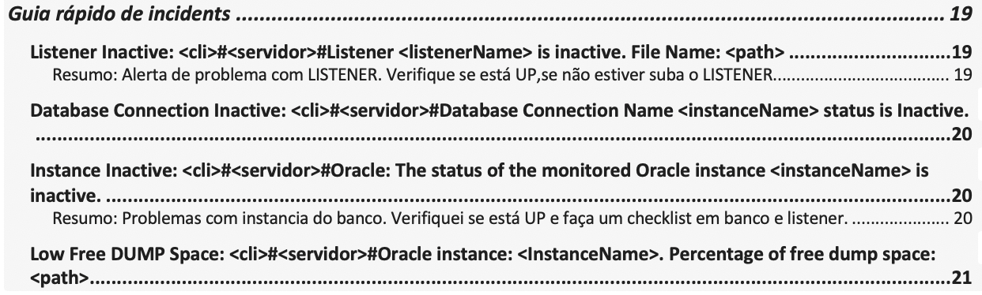
Exemplo de Alertas
las#localhost.localdomain#Listener LISTENER is inactive. File Name: /opt/oracle/product/12.2.0.1/dbhome_1/network
las#localhost.localdomain#Database Connection Name ORCL status is Inactive.
las#localhost.localdomain#Oracle instance: ORCL. Percentage of free dump space: /opt/oracle/diag/rdbms/orcl/ORCL

Slide 16
Checklist Completo
Oracle instances (sqlplus)
Verificar se todos os bancos do /etc/oratab estão ativos.
Espaço utilizado nas tablespaces(% utilizado).
Área de archives (% utilizado)
Verificar log das instancias (alert<sid>.log)
Listener
Verificar listener.ora se todos os listener estão UP ($ORACLE_HOME/network/admin/listener.ora)
Ultimos backups executados.
Caminhos / arquivos conhecidos.
/etc/oratab Instances do server
$ORACLE_HOME/network/admin/listener.ora Listener do Oracle_home
$ORACLE_HOME/network/admin/tnsnames.ora Config de clients
$ORACLE_HOME/dbs init/spfiles (unix)
%ORACLE_HOME%/database init/spfiles (windows)
$ORACLE_HOME/rdbms/admin scripts AWR, ADDM e etc.

Slide 17
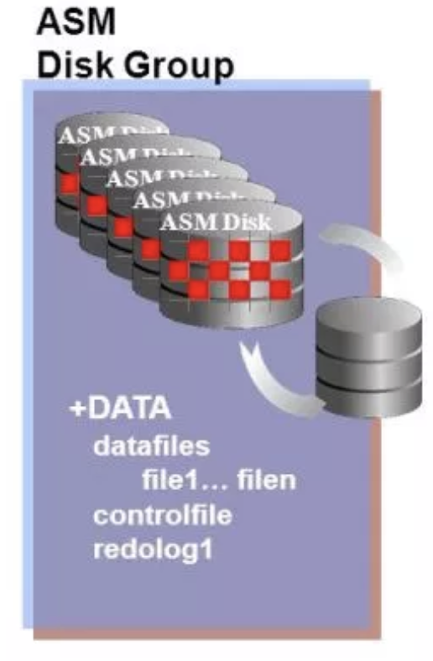
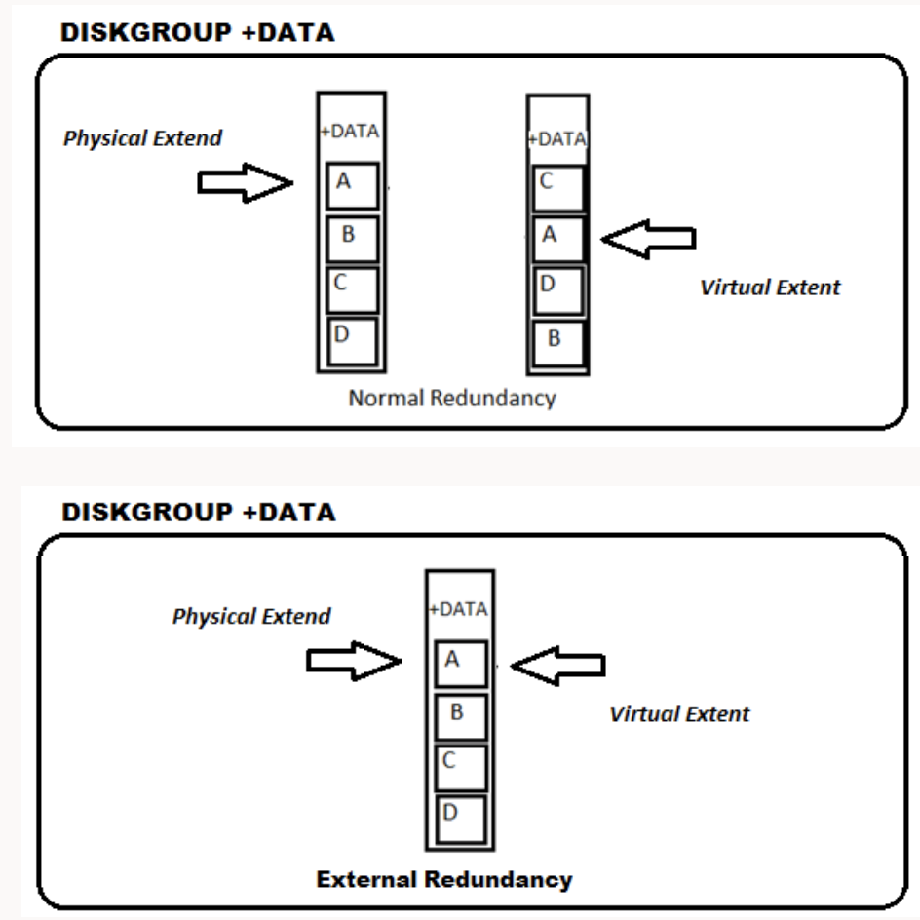
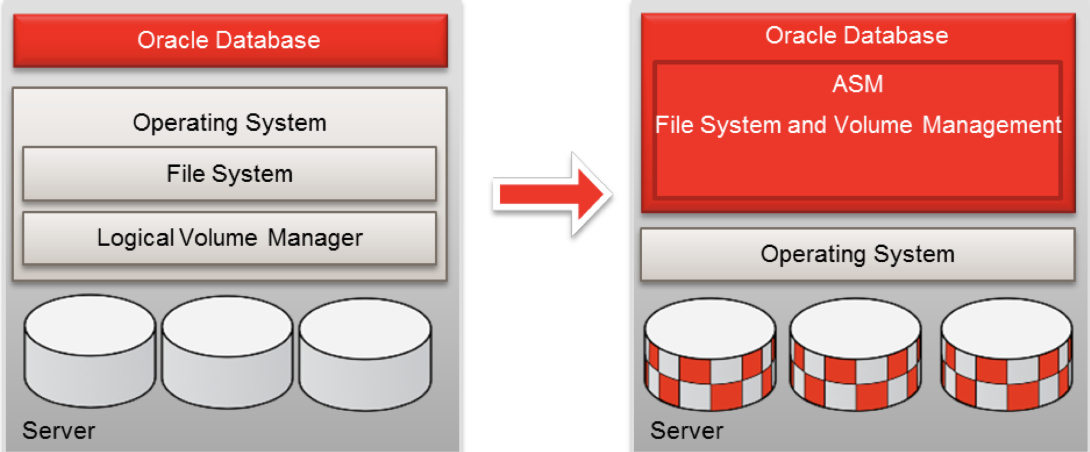
ASM - Automatic Storage Management
ASM é um sistema de arquivos (File system) e gerenciador de volumes para arquivos do banco de dados da Oracle
O que podemos colocar dentro do ASM?
Datafile, Controlfile, Redo Log File, Archive e Parameter File (spfile e/ou pfile)
Stripe
Mirror / Redundancia
EXTERNAL, NORMAL e HIGH (número de copias)

Slide 18
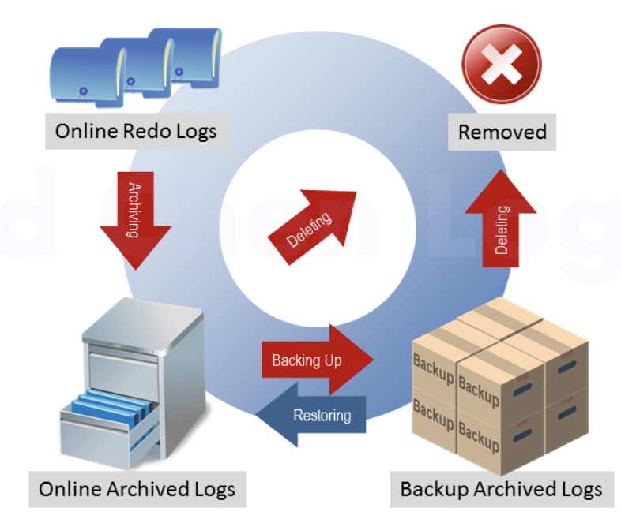
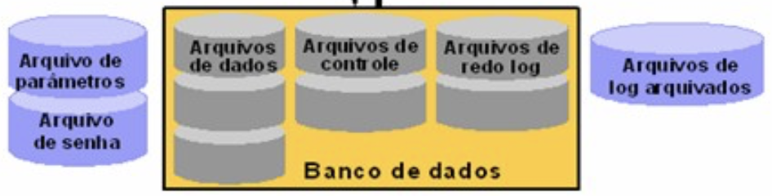
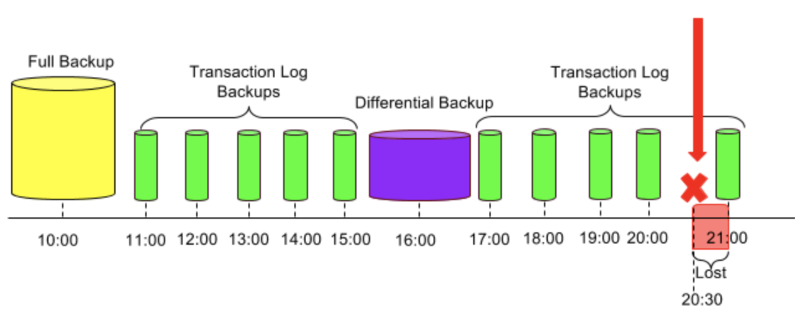
Archive
# Online Redo Log
Todas as alterações(transações) são armazenadas no ONLINE REDOLOG.
# Archived Log
Quando os Online Redologs enchem o banco gera arquivos externos chamados ARCHIVED LOGS.
# Quando vamos precisar de um archive
Para executar um recover
Atualizar um standby(dataguard)

Slide 19
Archive area / archive destination
Archive Mode não está ligado:
SQL> archive log list
Database log mode No Archive Mode
Automatic archival Disabled
Archive destination /opt/oracle/product/12.2.0.1/dbhome_1/dbs/arch
Oldest online log sequence 15
Current log sequence 17
Archive Mode ligado:
SQL> archive log list
Database log mode Archive Mode
Automatic archival Enabled
Archive destination USE_DB_RECOVERY_FILE_DEST
Oldest online log sequence 342354
Next log sequence to archive 342355
Current log sequence 342355
SQL> show parameters DB_RECO
NAME TYPE VALUE
--------------------------- ----------- ------------------------------
db_recovery_file_dest. string +FRA
db_recovery_file_dest_size big integer 100G
Archive destination = USE_DB_RECOVERY_FILE_DEST
precisa ser verificado limite configurado no parâmetro db_recovery_file_dest_size
SELECT space_used/space_limit*100 used FROM V$RECOVERY_FILE_DEST;
utilização do caminho especificado db_recovery_file_dest.(diskgroup (v$asm_diskgroup) ou filesystem (df -k))
Este SQL ajuda na identificação da área de archives.
col obs format a100
set linesize 1000
SELECT DEST_ID, STATUS, 'usando RECOVERY_FILE_DEST -> ' ||decode(DESTINATION,'USE_DB_RECOVERY_FILE_DEST','YES','NO') RECOVERY_FILE_DEST,
decode(substr(decode(DESTINATION,'USE_DB_RECOVERY_FILE_DEST',(select value from v$parameter where name='db_recovery_file_dest'),DESTINATION),1,1),'+','Verifique diskgroup: ',
'Verifique filesystem: df -k ')||
decode(DESTINATION,'USE_DB_RECOVERY_FILE_DEST',(select value from v$parameter where name='db_recovery_file_dest'),DESTINATION) OBS
FROM v$archive_dest WHERE status<>'INACTIVE' ;
DEST_ID STATUS RECOVERY_FILE_DEST OBS
--------- -------- -------------------------------- -----------------------------------
1 VALID usando RECOVERY_FILE_DEST -> YES Verifique diskgroup: +FRA
Outros parametros:
show parameters archive

Slide 20
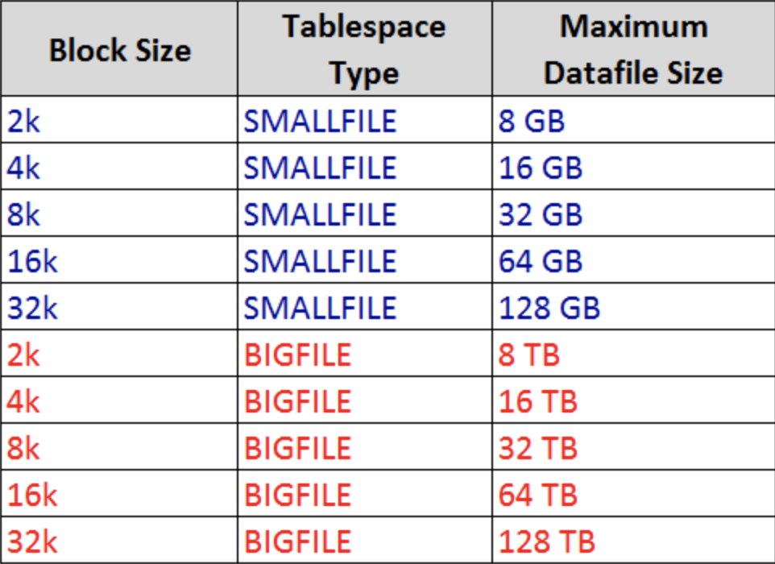
Crescendo tablespaces
Verifique o percentual utilizado e entenda o quanto precisa crescer.
Liste os datafiles
Verifique o espaço livre do destino do datafile antes de crescer a tablespace (filesystem> df –k, ASM > v$diskgroup).
Crescer a tablespace (add datafile ou resize)
# exemplo resize datafile filesystem / ASM
SQL> alter database datafile '/opt/oracle/oradata/ORCL/users02.dbf' resize 30720m;
SQL> alter database datafile '+DATA/IM4/DATAFILE/users.273.1074803439' resize 30720m;
# exemplo add datafile filesystem
SQL> alter tablespace USERS add datafile '/opt/oracle/oradata/ORCL/users02.dbf' size 30720m;
# exemplo add datafile em ASM
SQL> alter tablespace USERS add datafile '+DATA' size 30720m;
SQL> alter tablespace USERS add datafile '+DATA/IM4/DATAFILE/users.274' size 30720m;
ORA-00059: maximum number of DB_FILES exceeded
[oracle@localhost admin]$ oerr ORA 00059
00059, 00000, "maximum number of DB_FILES exceeded"
// *Cause: The value of the DB_FILES initialization parameter was exceeded.
// *Action: Increase the value of the DB_FILES parameter and warm start.
SQL> show parameters db_files
NAME TYPE VALUE
--------- ----------- ------
db_files integer 200
ORA-01144 File Size exceeds maximum of 4194303 Blocks
[oracle@localhost admin]$ oerr ORA 01144
01144, 00000, "File size (%s blocks) exceeds maximum of %s blocks"
// *Cause: Specified file size is larger than maximum allowable size value.
// *Action: Specify a smaller size.
SQL> show parameters db_block_size
NAME TYPE VALUE
------------------- ------- --------
db_block_size integer 8192

Slide 21
LAB 4 – Simulação de chamado reativo (cliente)
Sumulação: Cliente reclamou do banco ORCL
Executar Checklist:
Conectar no banco e rodar (sql)
Listar processos de listener e banco.
Listar utilização de tablespace e DISKGROUPs(asm)
Olhar o log do banco (alert)
abrir arquivo
ir para o final do arquivo (G)
buscar do final para cima as mensagens ORA- (?ORA-)
Notes:
Criar um problema pra incentivar a pesquisa de msg de erros, analise do impacto no banco e correção

Slide 22
LAB 5 – Shutdown immediate / startup
Abra duas conexões no servidor de LAB.
Faça sudo para o usuário do banco.
Na conexão 1 :
Encontre o log do banco ORCL e execute:
tail –f alert_ORCL.log
Shutting down instance (immediate) (OS id: 4510)
...
Instance shutdown complete (OS id: 4510)
Starting ORACLE instance (normal) (OS id: 4550)
...
Completed: ALTER DATABASE OPEN
Na conexão 2 :
Conecte no banco e execute:
SQL> shutdown immediate;
Database closed.
Database dismounted.
ORACLE instance shut down.
Observe a movimentação do log durante a execução.
SQL> startup
ORACLE instance started.
Total System Global Area 629145600 bytes
Fixed Size 8623832 bytes
Variable Size 515901736 bytes
Database Buffers 96468992 bytes
Redo Buffers 8151040 bytes
Database mounted.
Database opened.

Slide 23
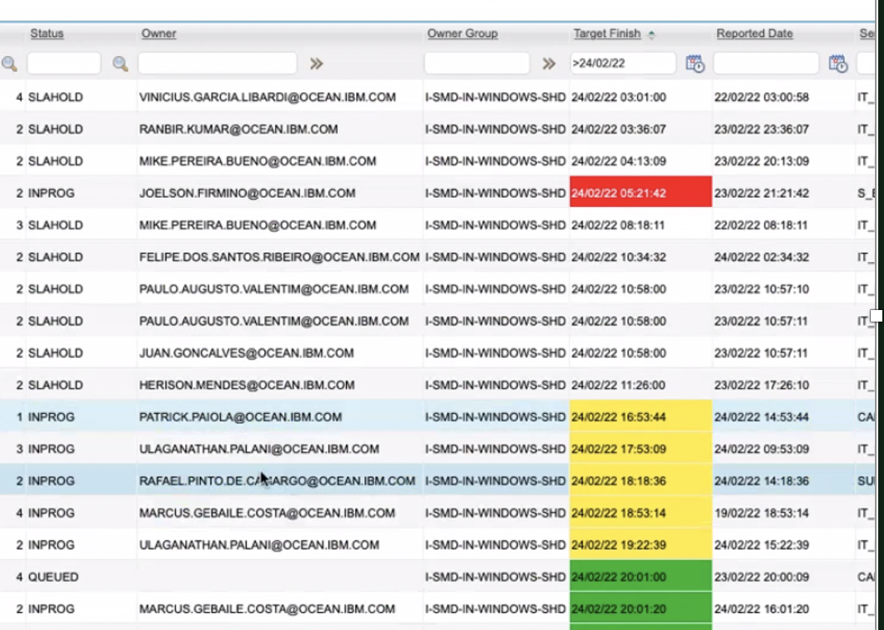
MAXIMO – Fila / SLA
Dar preferência aos chamados escalados (cobrados pelo ISM)
Sem chamado escalado, de preferência aos chamados NÃO vencidos:
Usar filtro no “Target Finish” – maior que a data atual.
Filtrar por INPROG + QUEUE
Ordenar por “Target Finish”

Slide 24
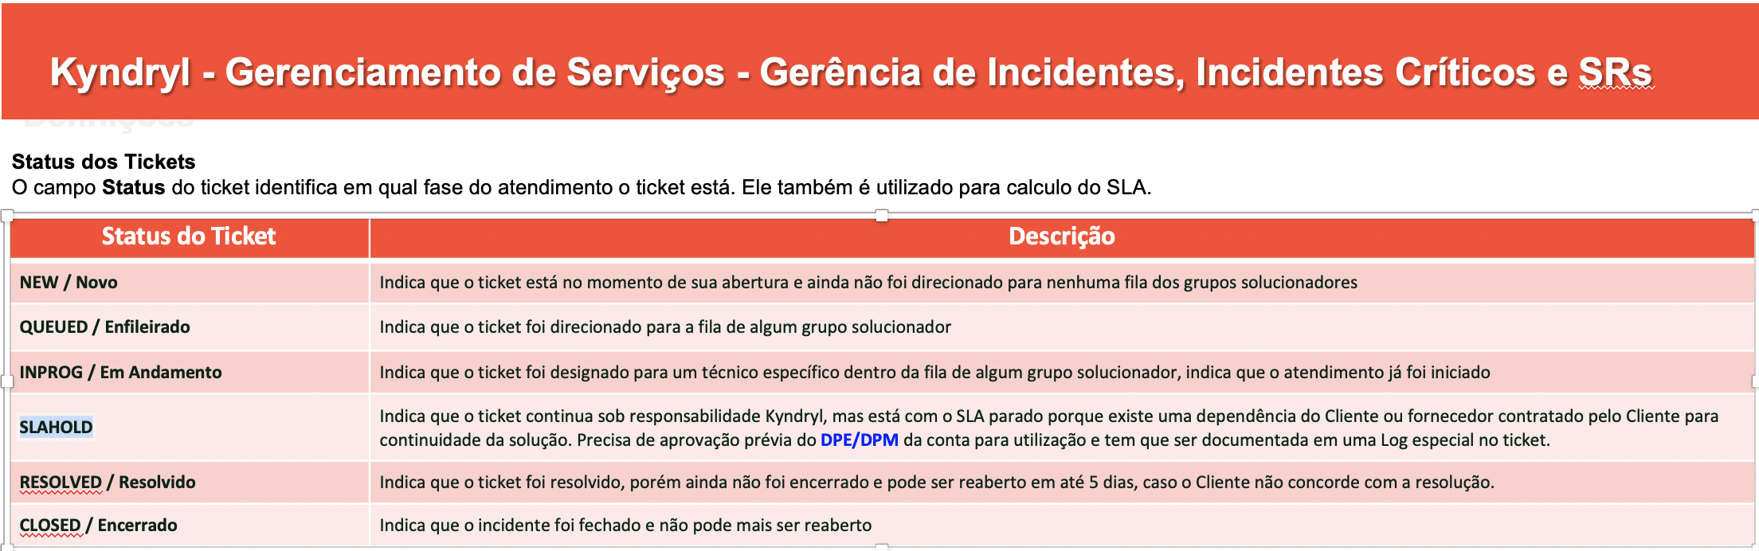
MAXIMO - Importante sobre IN/SR
Não usar status REJECT.. usar RESOLVED para fechar um chamado.
NÃO colocar em SLAHOLD com informação sobre “aguardar horário comercial”.
Nunca colocar senha em logs de chamados(FALHA DE SEGURANÇA).
Enviar via email a senha para o solicitante/dono do usuário.
Colocar no chamado evidências da ação executada:
Evidencia de espaço utilizado em filesystem / tablespaces e etc.
Evidencia do checklist do banco / listener.
etc...

Slide 25
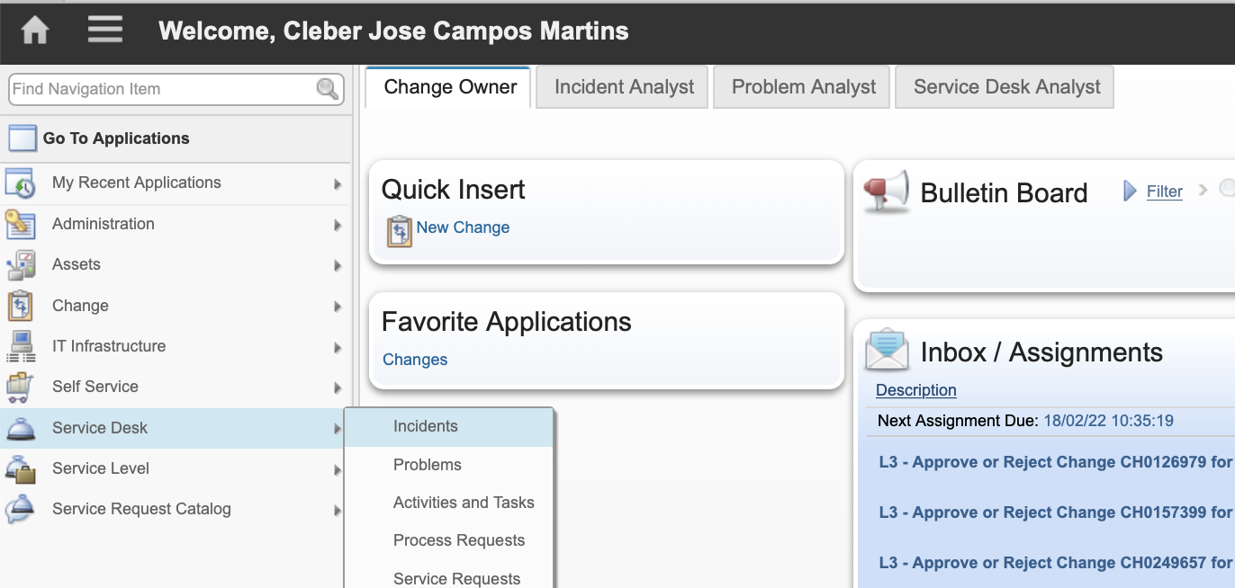
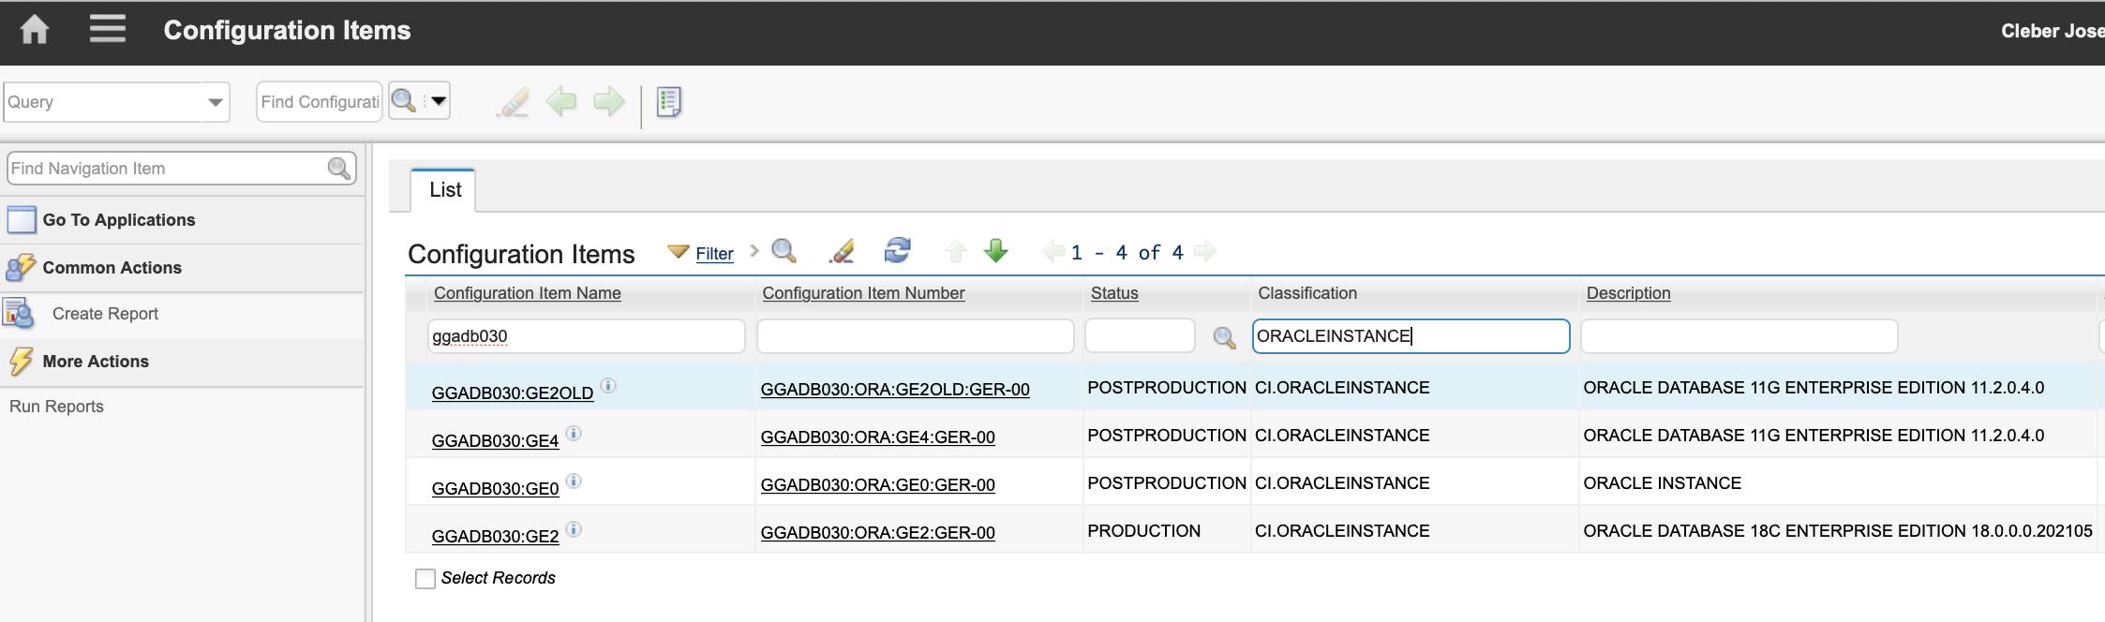
MAXIMO - Verificando cadastro do CI dos bancos.
1
2
3 - filtros

Slide 26
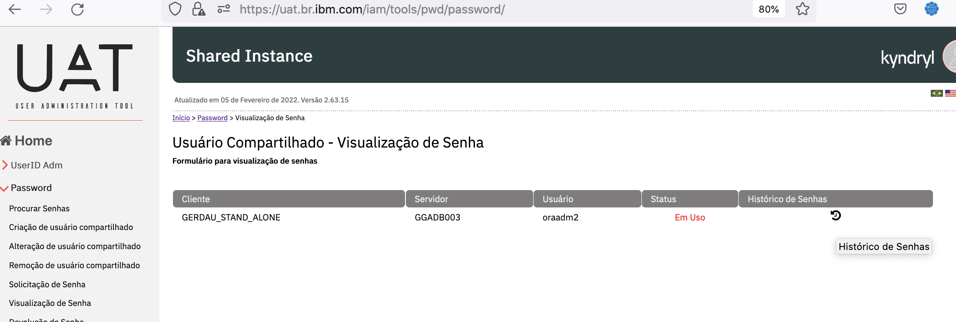
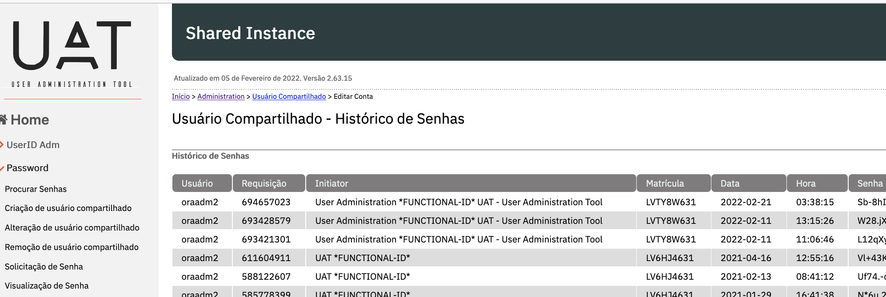
UAT – Dicas – Histórico de senhas
Histórico de senhas aparece após expirar a visualização da senha.
Se o usuário solitado não funcionar, pode ser que o anterior funcione.

Slide 27
Thank you

